Slide 1
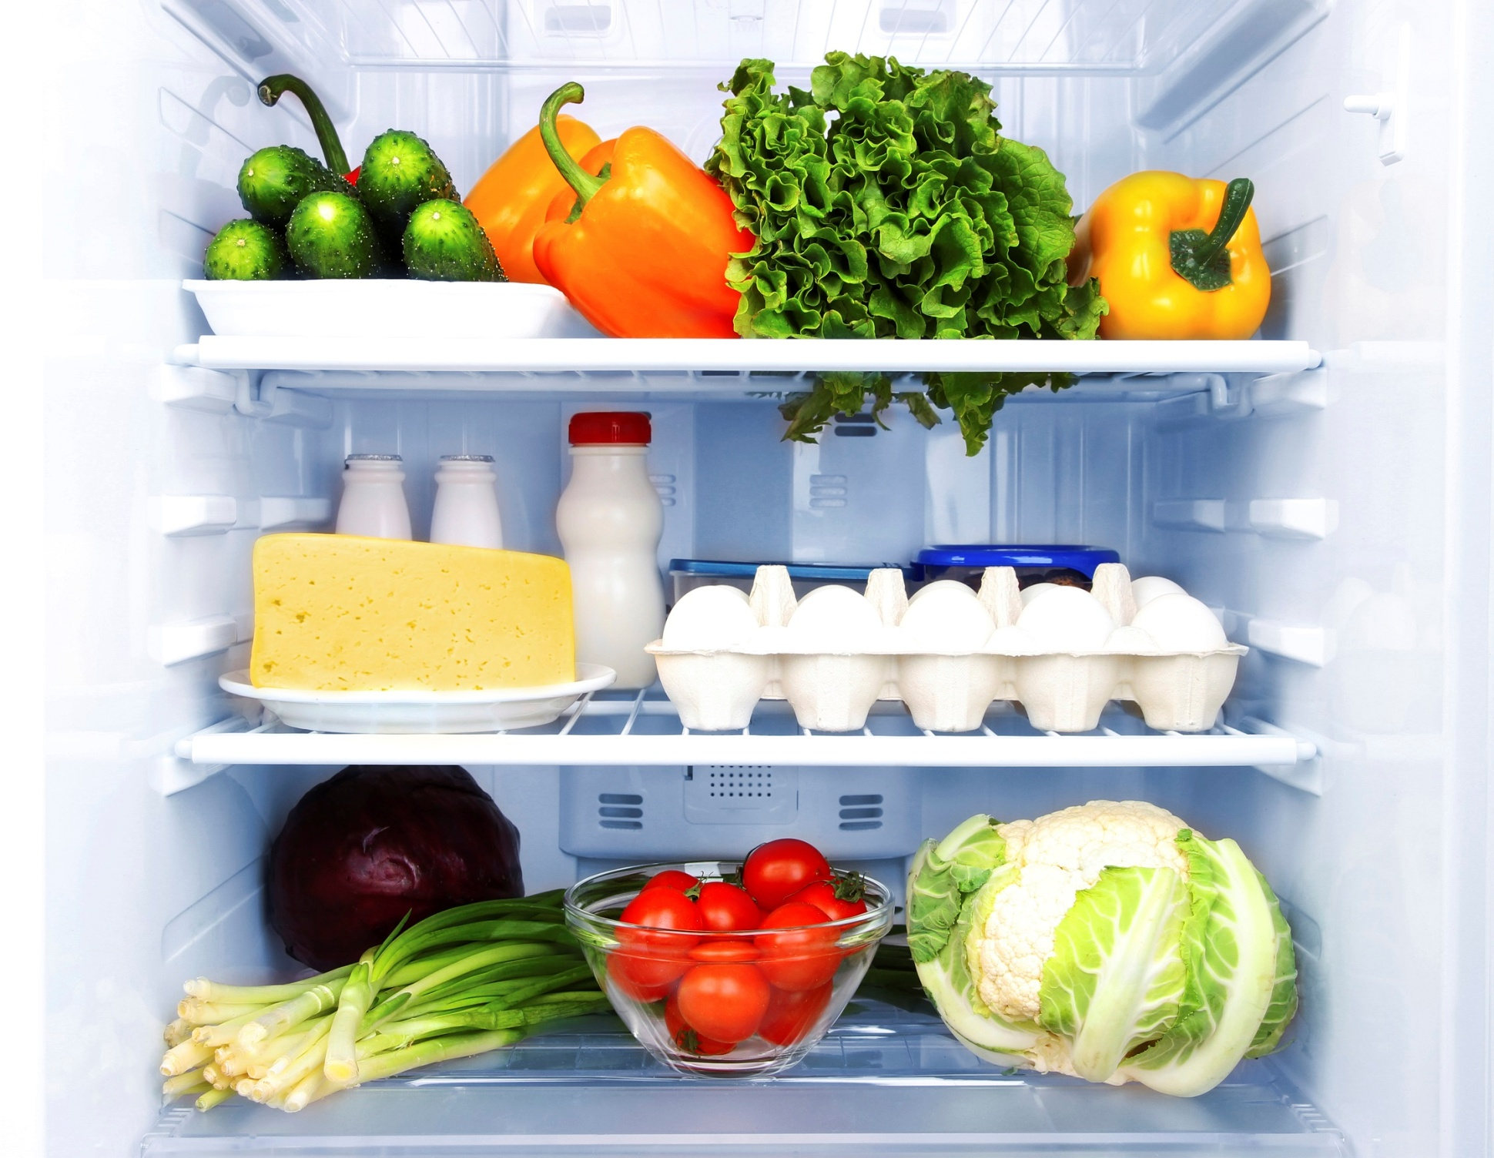

Slide 2
x
o
x
o
x
o
1
2
3
x
o
x
o
x
o
4
5
6
x
o
x
o
x
o
7
8
9

Slide 3
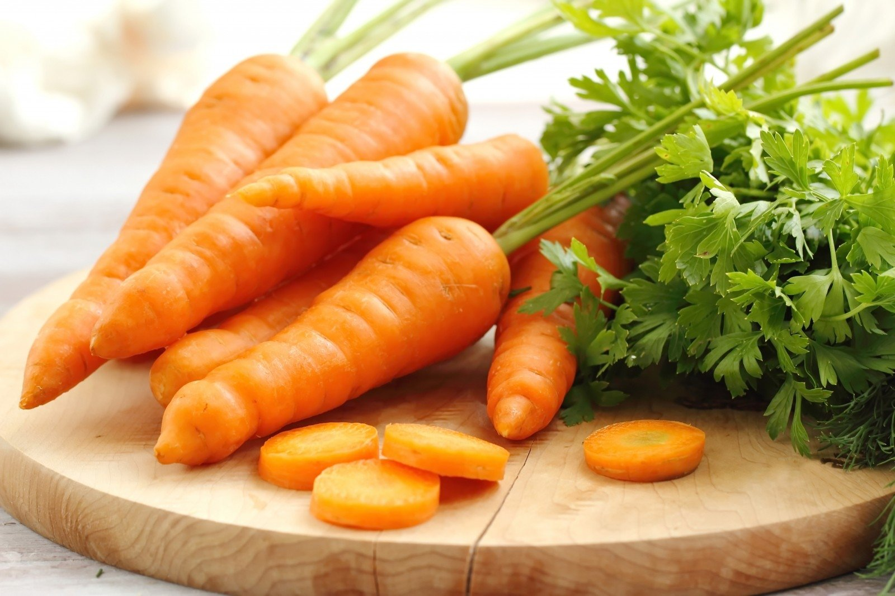
He doesn’t have any carrots.

Slide 4
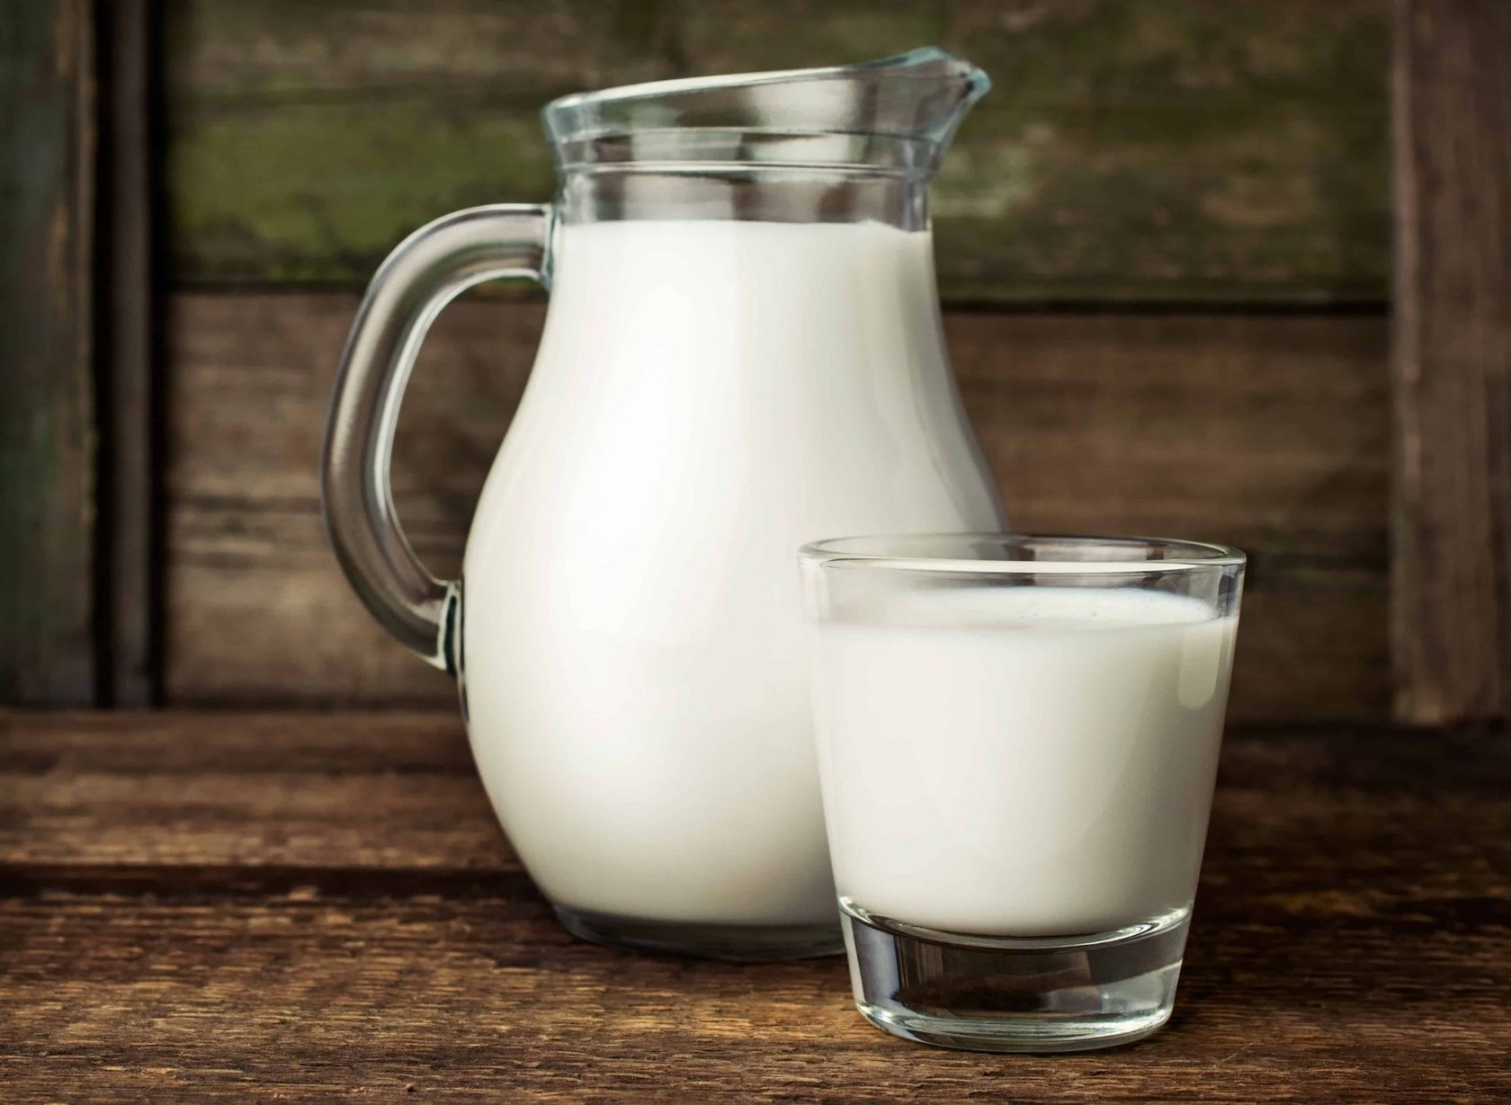
?
Does he have any milk?

Slide 5
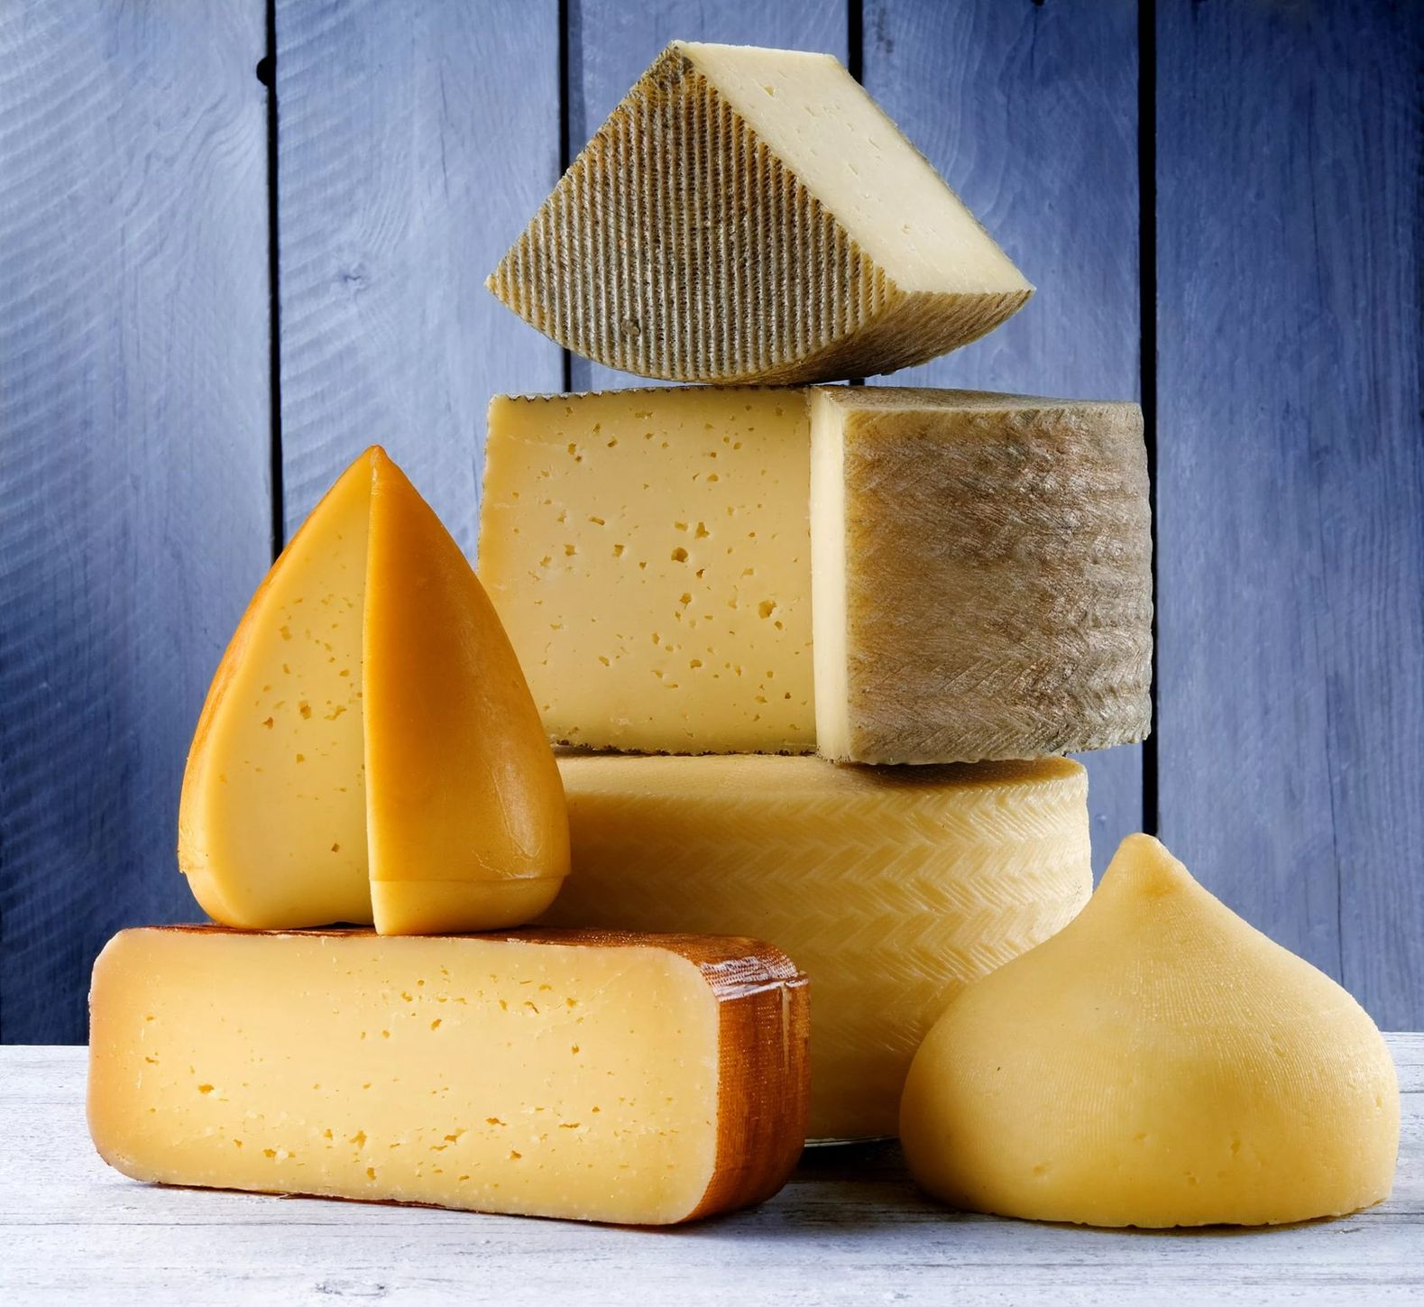
+
He has some cheese.

Slide 6
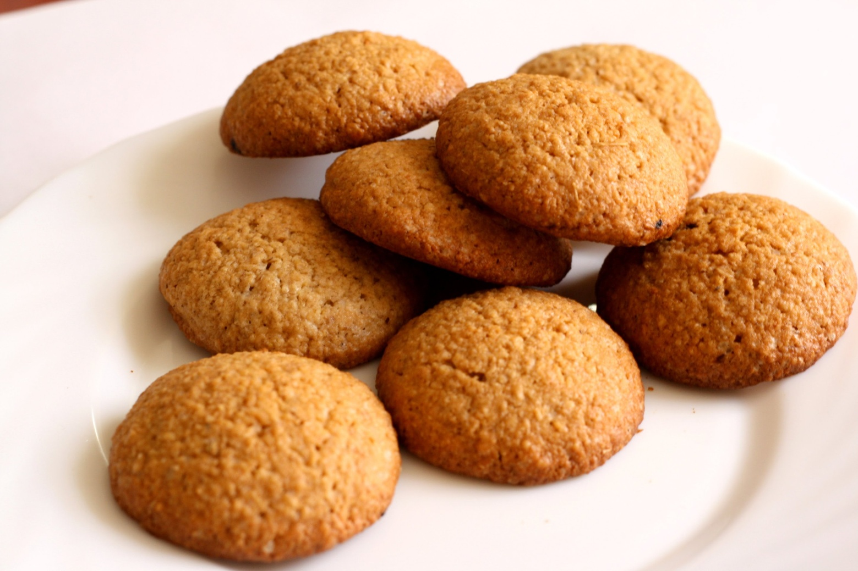
+
He has some biscuits.

Slide 7
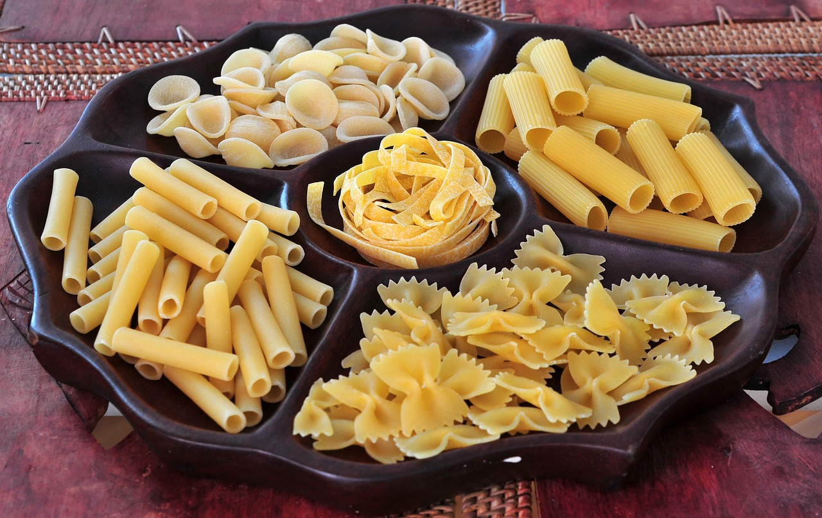
He doesn’t have any pasta.

Slide 8
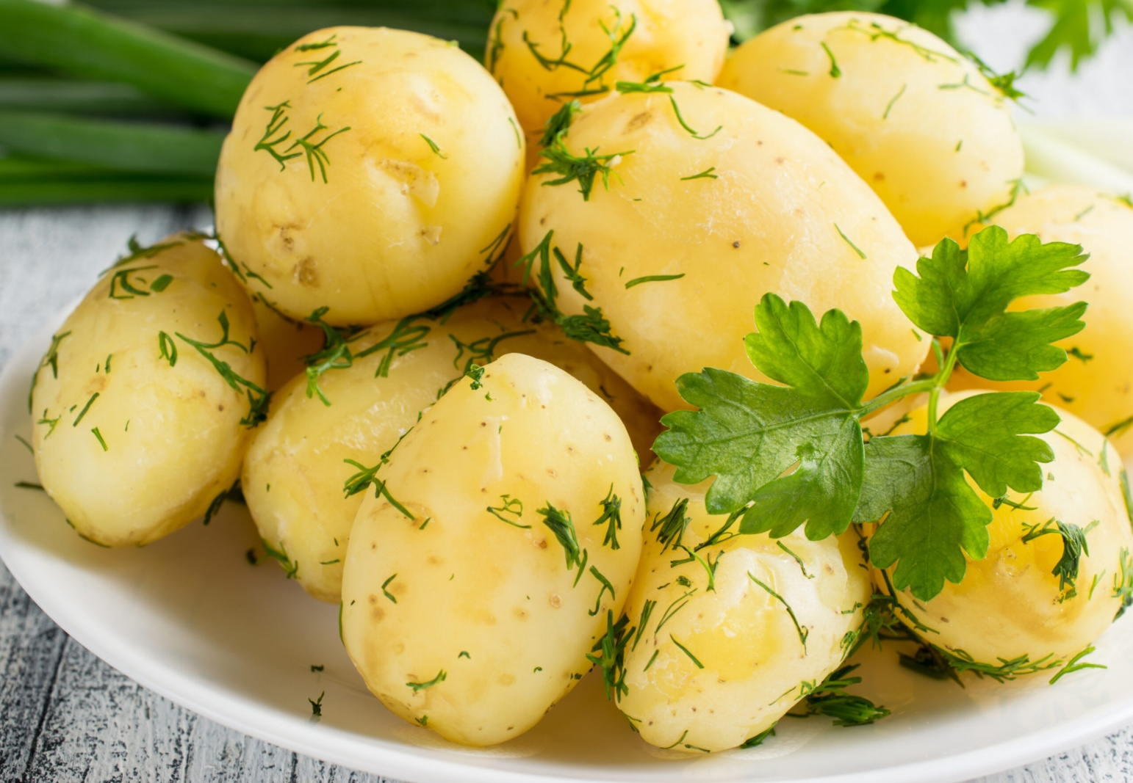
?
Does he have any potatoes?

Slide 9
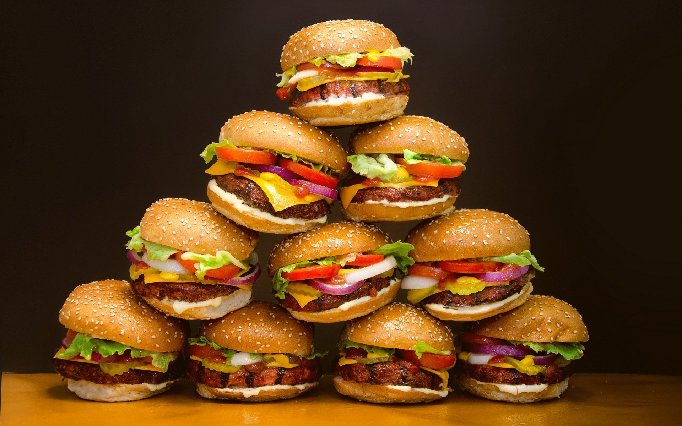
?
Does he have any burgers?

Slide 10
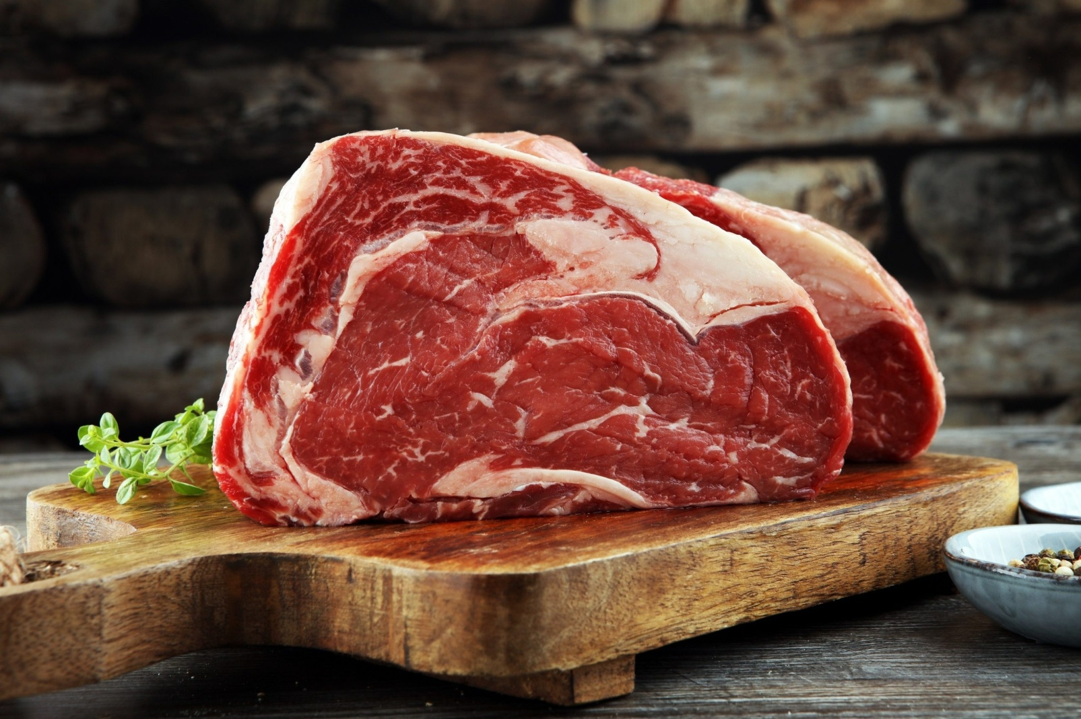
+
He has some meat.

Slide 11
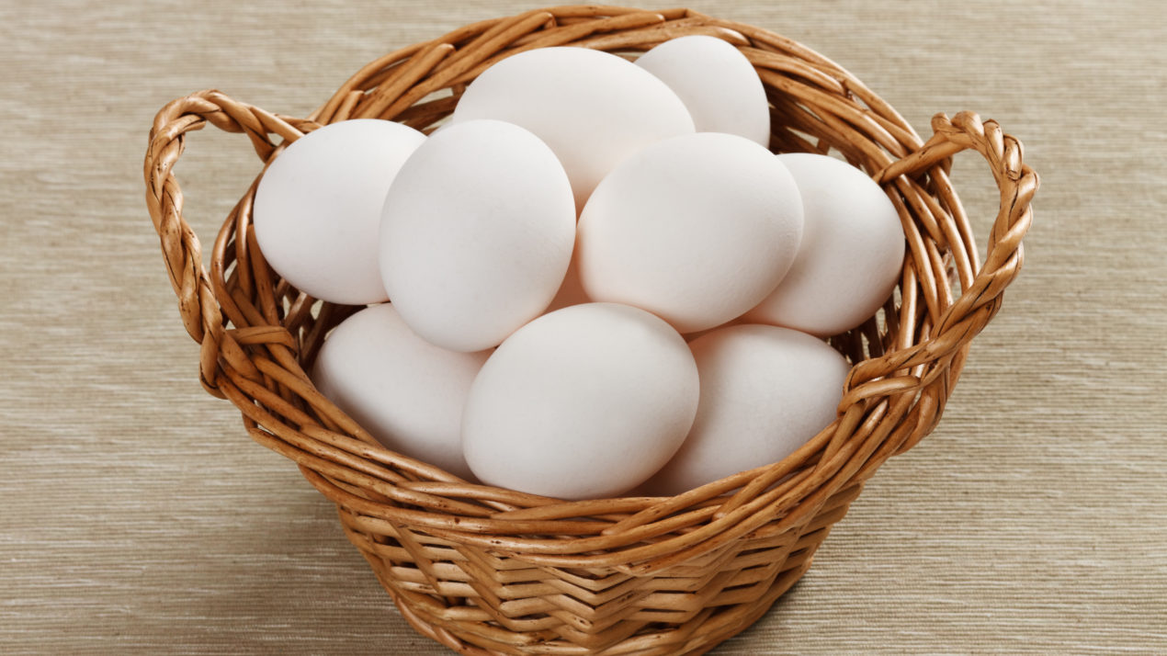
+
He has some eggs.

Slide 12
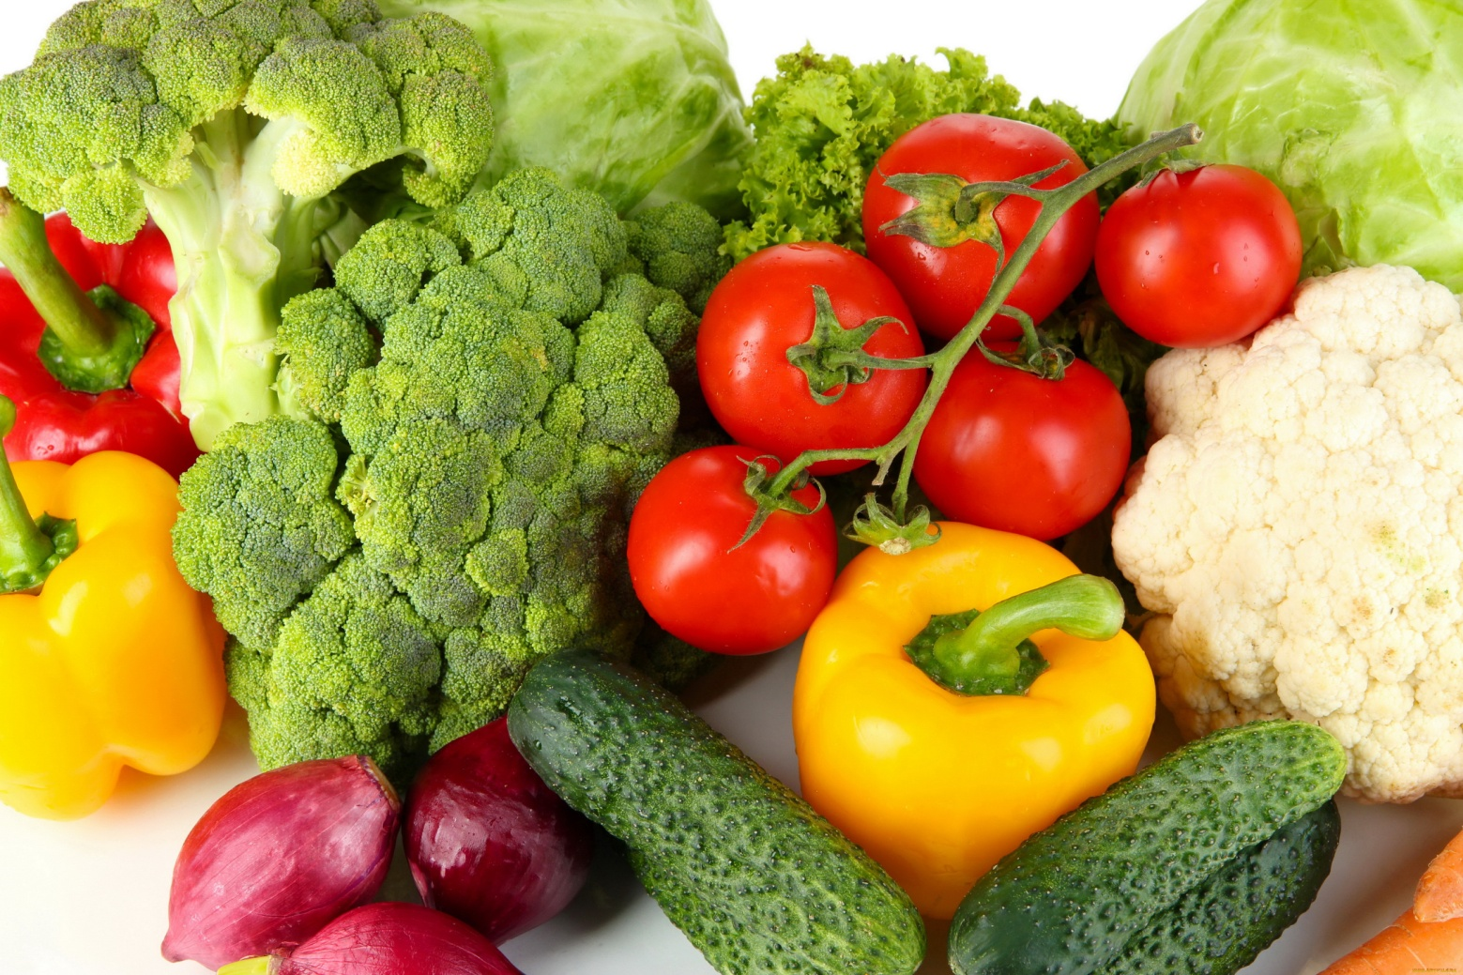
?
Does he have any vegetables?

